Slide 1
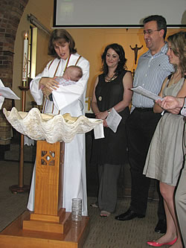
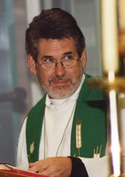
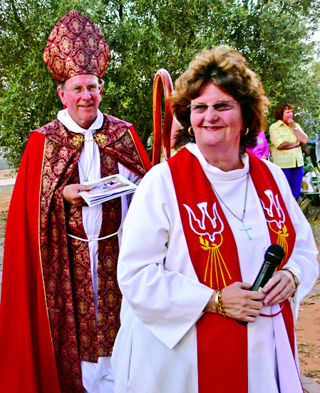
What is Anglican?
Notes:
WHAT IS ANGLICAN? – you’re at a bbq and someone asks what you do for a living. You say you work in an Anglican school and they ask, oh, what is Anglican? What do you say?

Slide 2
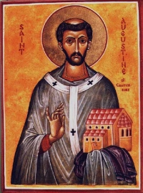
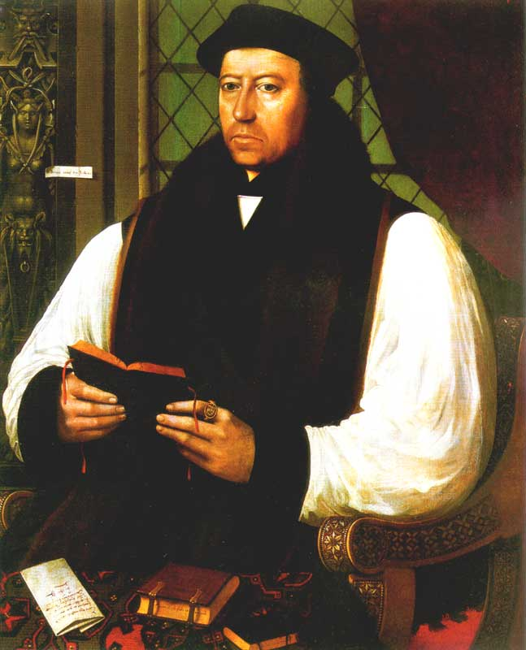
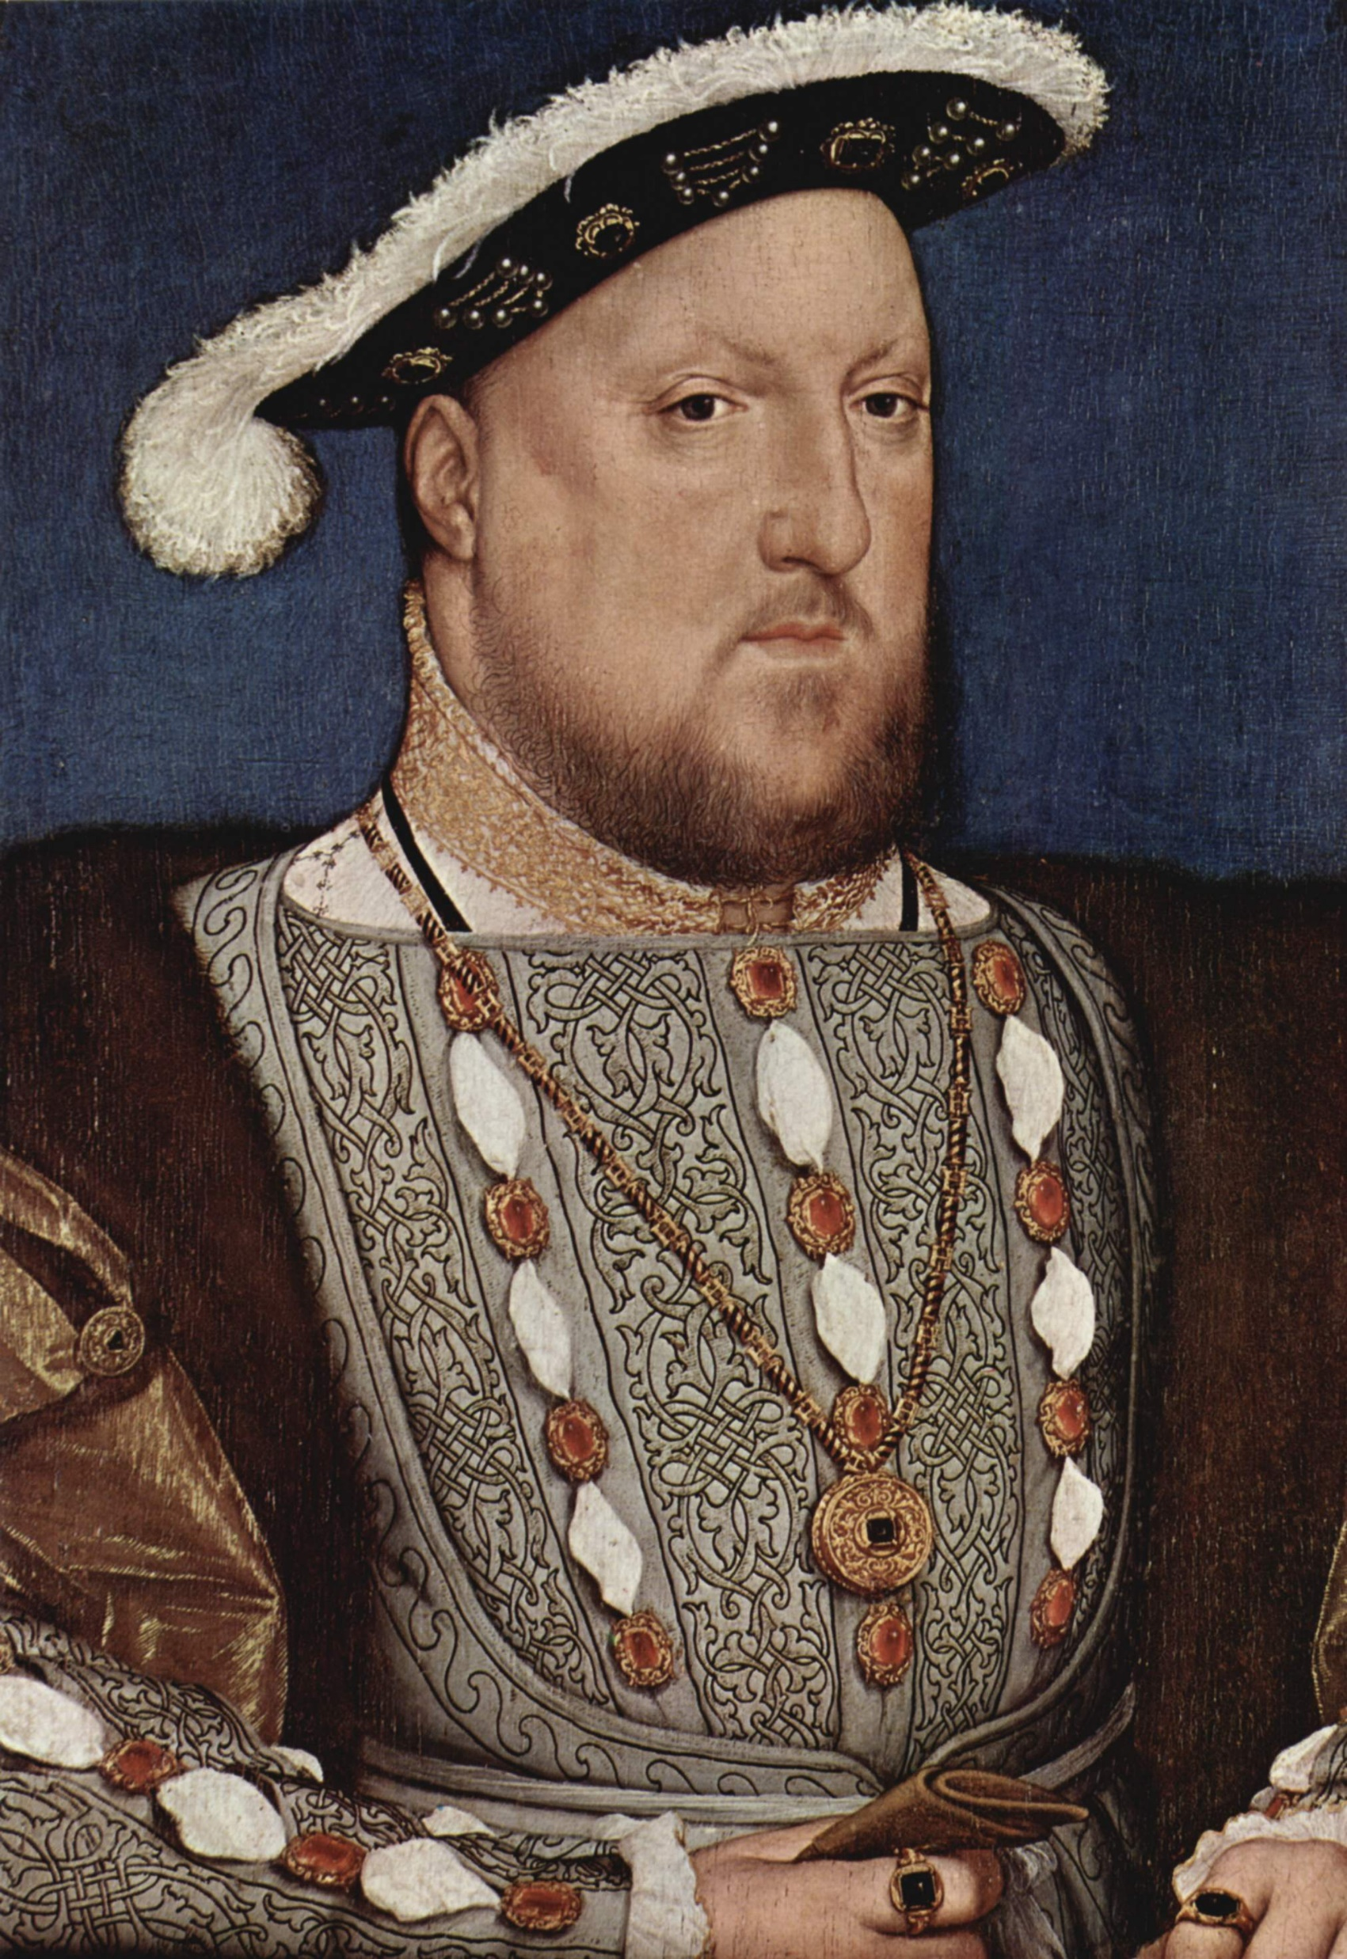
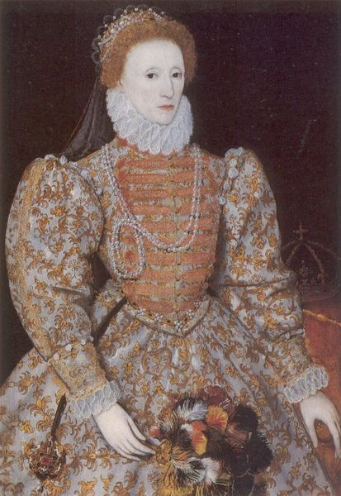
Reformation origin?
There is a distinctively English church long before Henry VIII
In some ways, Henry was merely catching up to the way the Church operated in some other European states
Thomas Cranmer and Richard Hooker articulated an English church
Elizabeth saw a ‘Church of England’ as a kind of glue that could unite a nation
Notes:
St Augustine of Canterbury in England at the end of the sixth century /Celtic Christianity remained distinctive even after it was suppressed in 664CE
Thomas Cranmer - a leader of the English Reformation and Archbishop of Canterbury during the reigns of Henry VIII
Henry 8
Elizabeth

Slide 3
the encounter with God
Notes:
Anglican Christianity begins, for each individual, with an encounter with God through the person of Jesus of Nazareth, called the Christ by Christians. Anglicanism is, of course, about faith and the way one sees one’s relationship with God. In other words, Anglicanism is a way of understanding our relationship with God, Jesus, the world and each other.

Slide 4
For Anglicans, how can God be known?
Scripture
Tradition
Reason
Notes:
Richard Hooker himself (c. 1554-Nov. 2, 1600) never used the phrase, but is widely acknowledged to be the developer of the idea of the sources of knowledge, or revelation about God, known as scripture, tradition, and reason.
These terms have, though, come to designate the sources that mediate Christian faith, inform the understanding of that faith and shape the order and discipline of the church. They have also come to designate a method by which Christian faith is understood, sometimes identified as the three legs of a stool.
One often reads about experience as a fourth leg. Anglican priest John Wesley (1703-1791) coined the Wesleyan Quadrilateral that included experience with the other three sources of revelation. It should be added that reason for Richard Hooker was not thought of in the same way as we know theoretical reasoning. Reason was understood in a classical sense, drawing from Plato and Aristotle, as a participatory knowledge. To know something was to experience it, to share or participate in something. As such, reason may be best understood as a practical wisdom and is inextricably linked to experience.

Slide 5
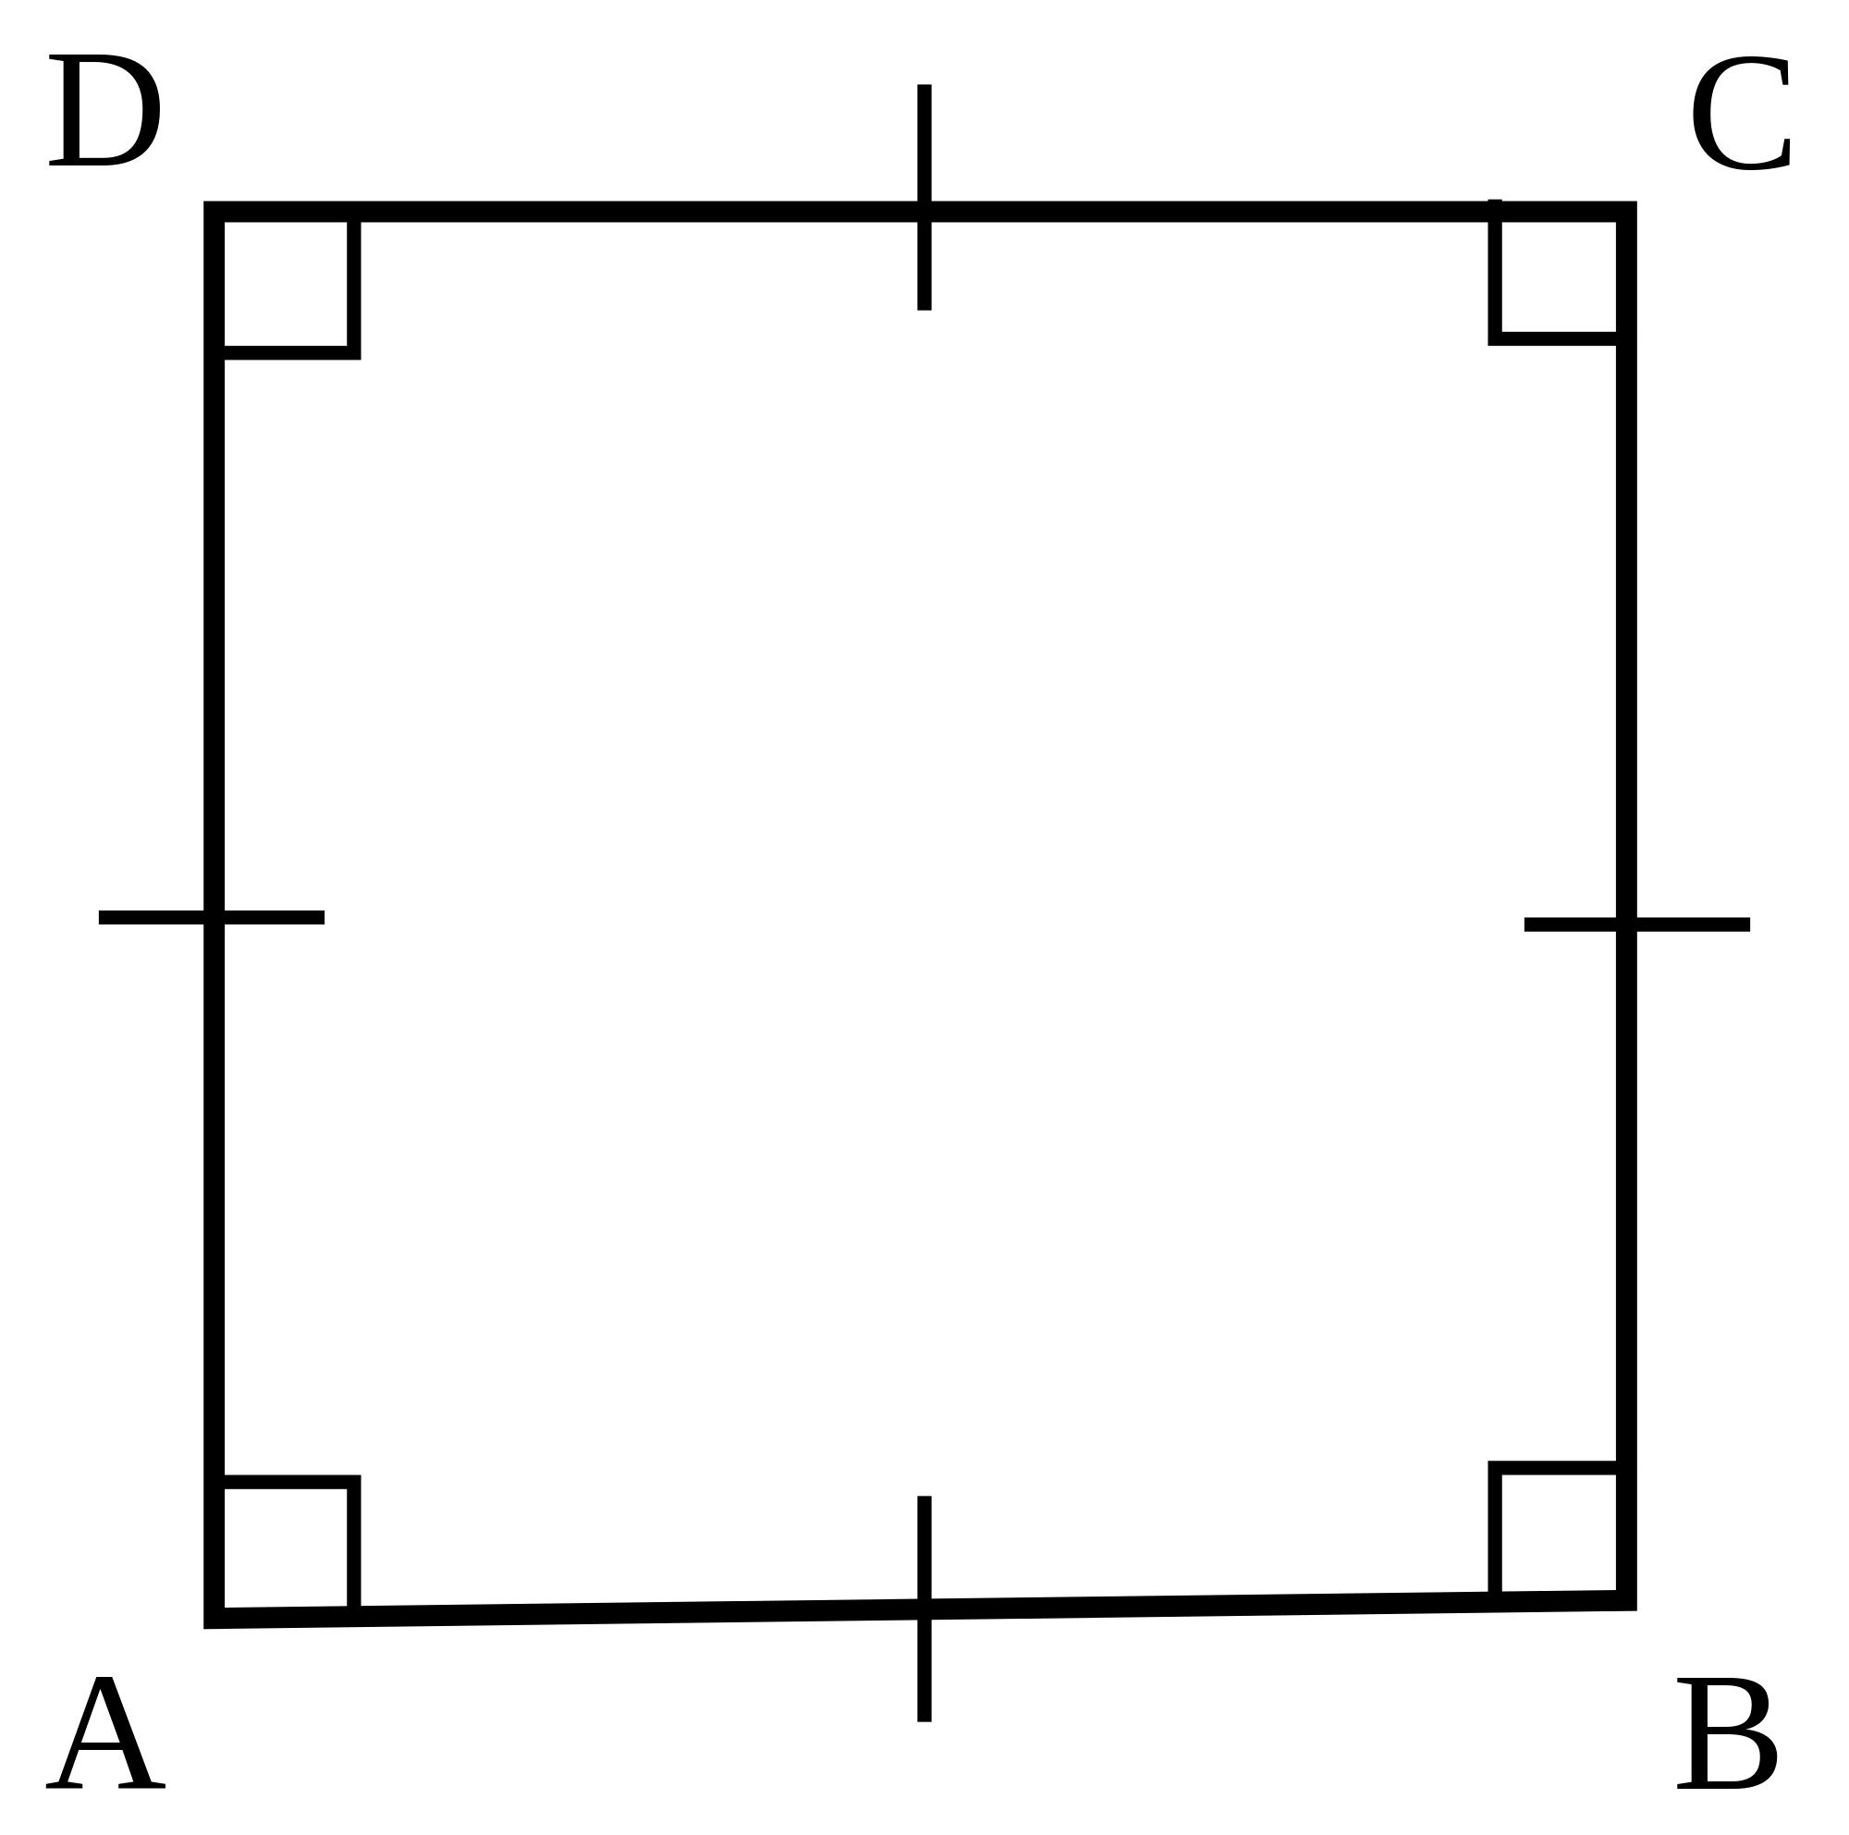
The Holy Scriptures of the Old and New Testaments
The Creeds,
(c) The two Sacraments, Baptism and the Eucharist
(d) The Historic Episcopate
The Lambeth Quadrilateral
Notes:
Not a confessional church, despite the Quad and docs like the 39 articles (which, scholars suggest, has lots of “oughts mays and should” rather than musts!!)

Slide 6
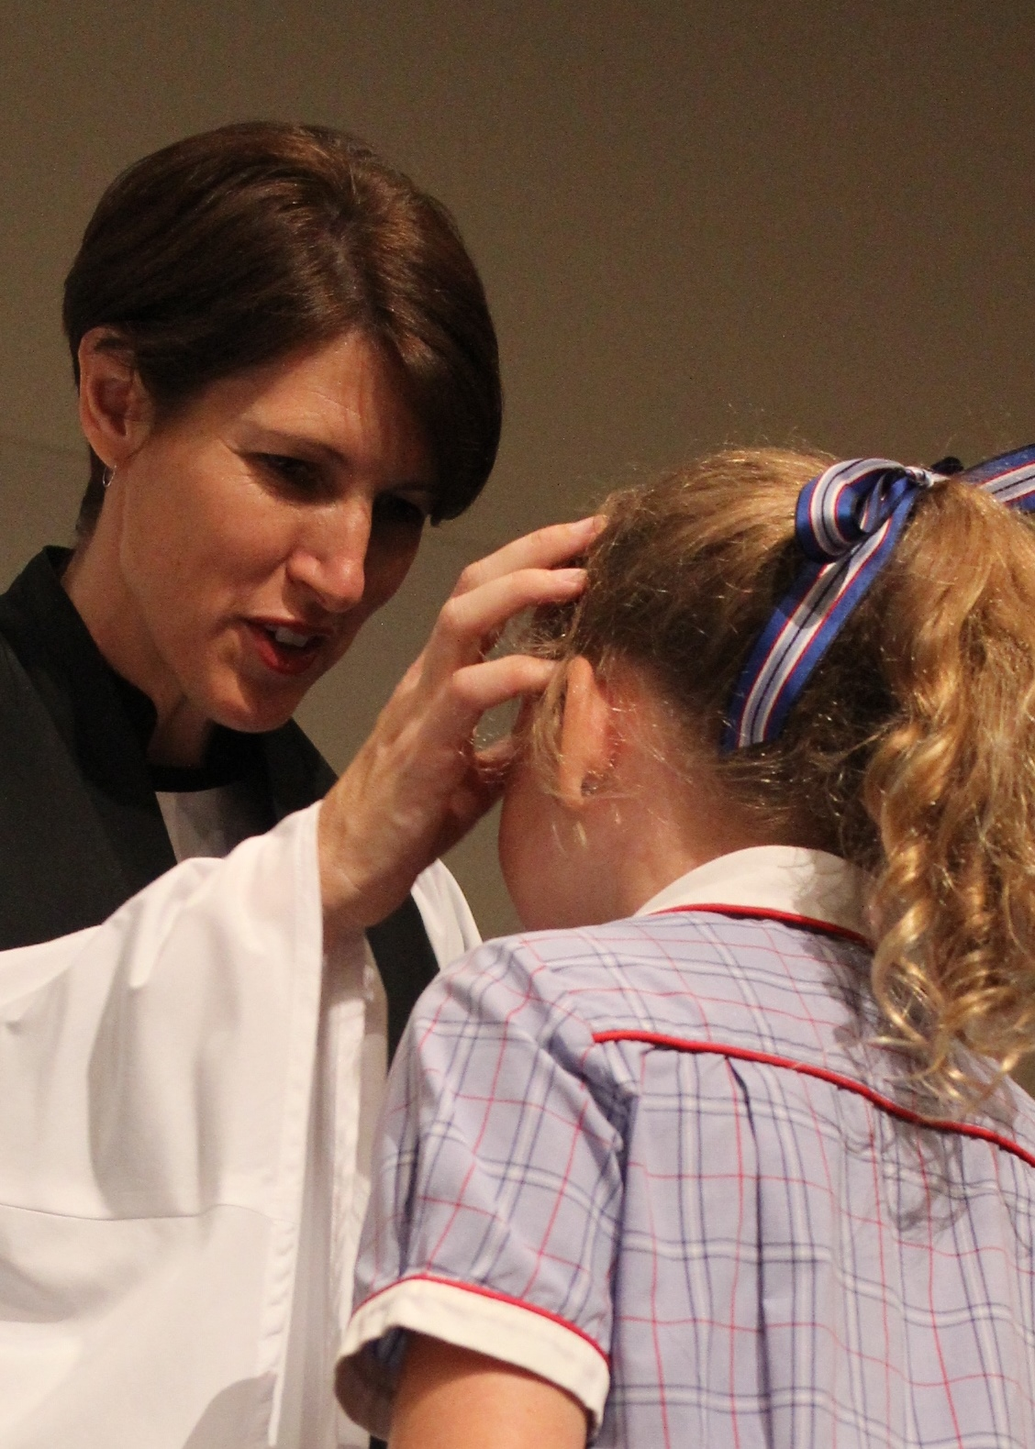
‘Lex orandi, lex credendi’
the law of prayer is the law of belief
i.e. How the church prays
witnesses to what the church believes
Notes:
This famous ancient Christian principle (from the 4th century Prosper of Aquitaine) sums up a key spiritual theme which Anglicans share, especially, with Orthodox Christians
‘Lex orandi, lex credendi’ - translated as ‘the law of prayer is the law of belief’
It helps explain why Anglicans are typically concerned about the details of liturgy – for what and how we pray reflects what we believe
To find out what Anglicans believe, therefore look at the Prayer Book!

Slide 7
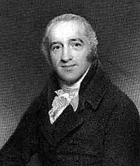
‘The Bible first, the Prayer Book second and all other books in subordination to both.’
Charles Simeon, 18th century
Notes:
The Anglican Prayer Book has historically been central to Anglican spirituality and self-understanding – across the range of catholic and reformed traditions within the Anglican Church
This quotation sums up Anglican attitudes well - from Charles Simeon, founder of the Church Missionary Society and one of the ‘fathers of Evangelicalism’
Note that for Anglicans, we see the prayer book as
Making use of the best of biblical and liturgical scholarship
- Honouring the ancient Christian heritage
- Renewing the monastic rhythms of prayer (cf. Morning & Evening Prayer) for all people

Slide 8
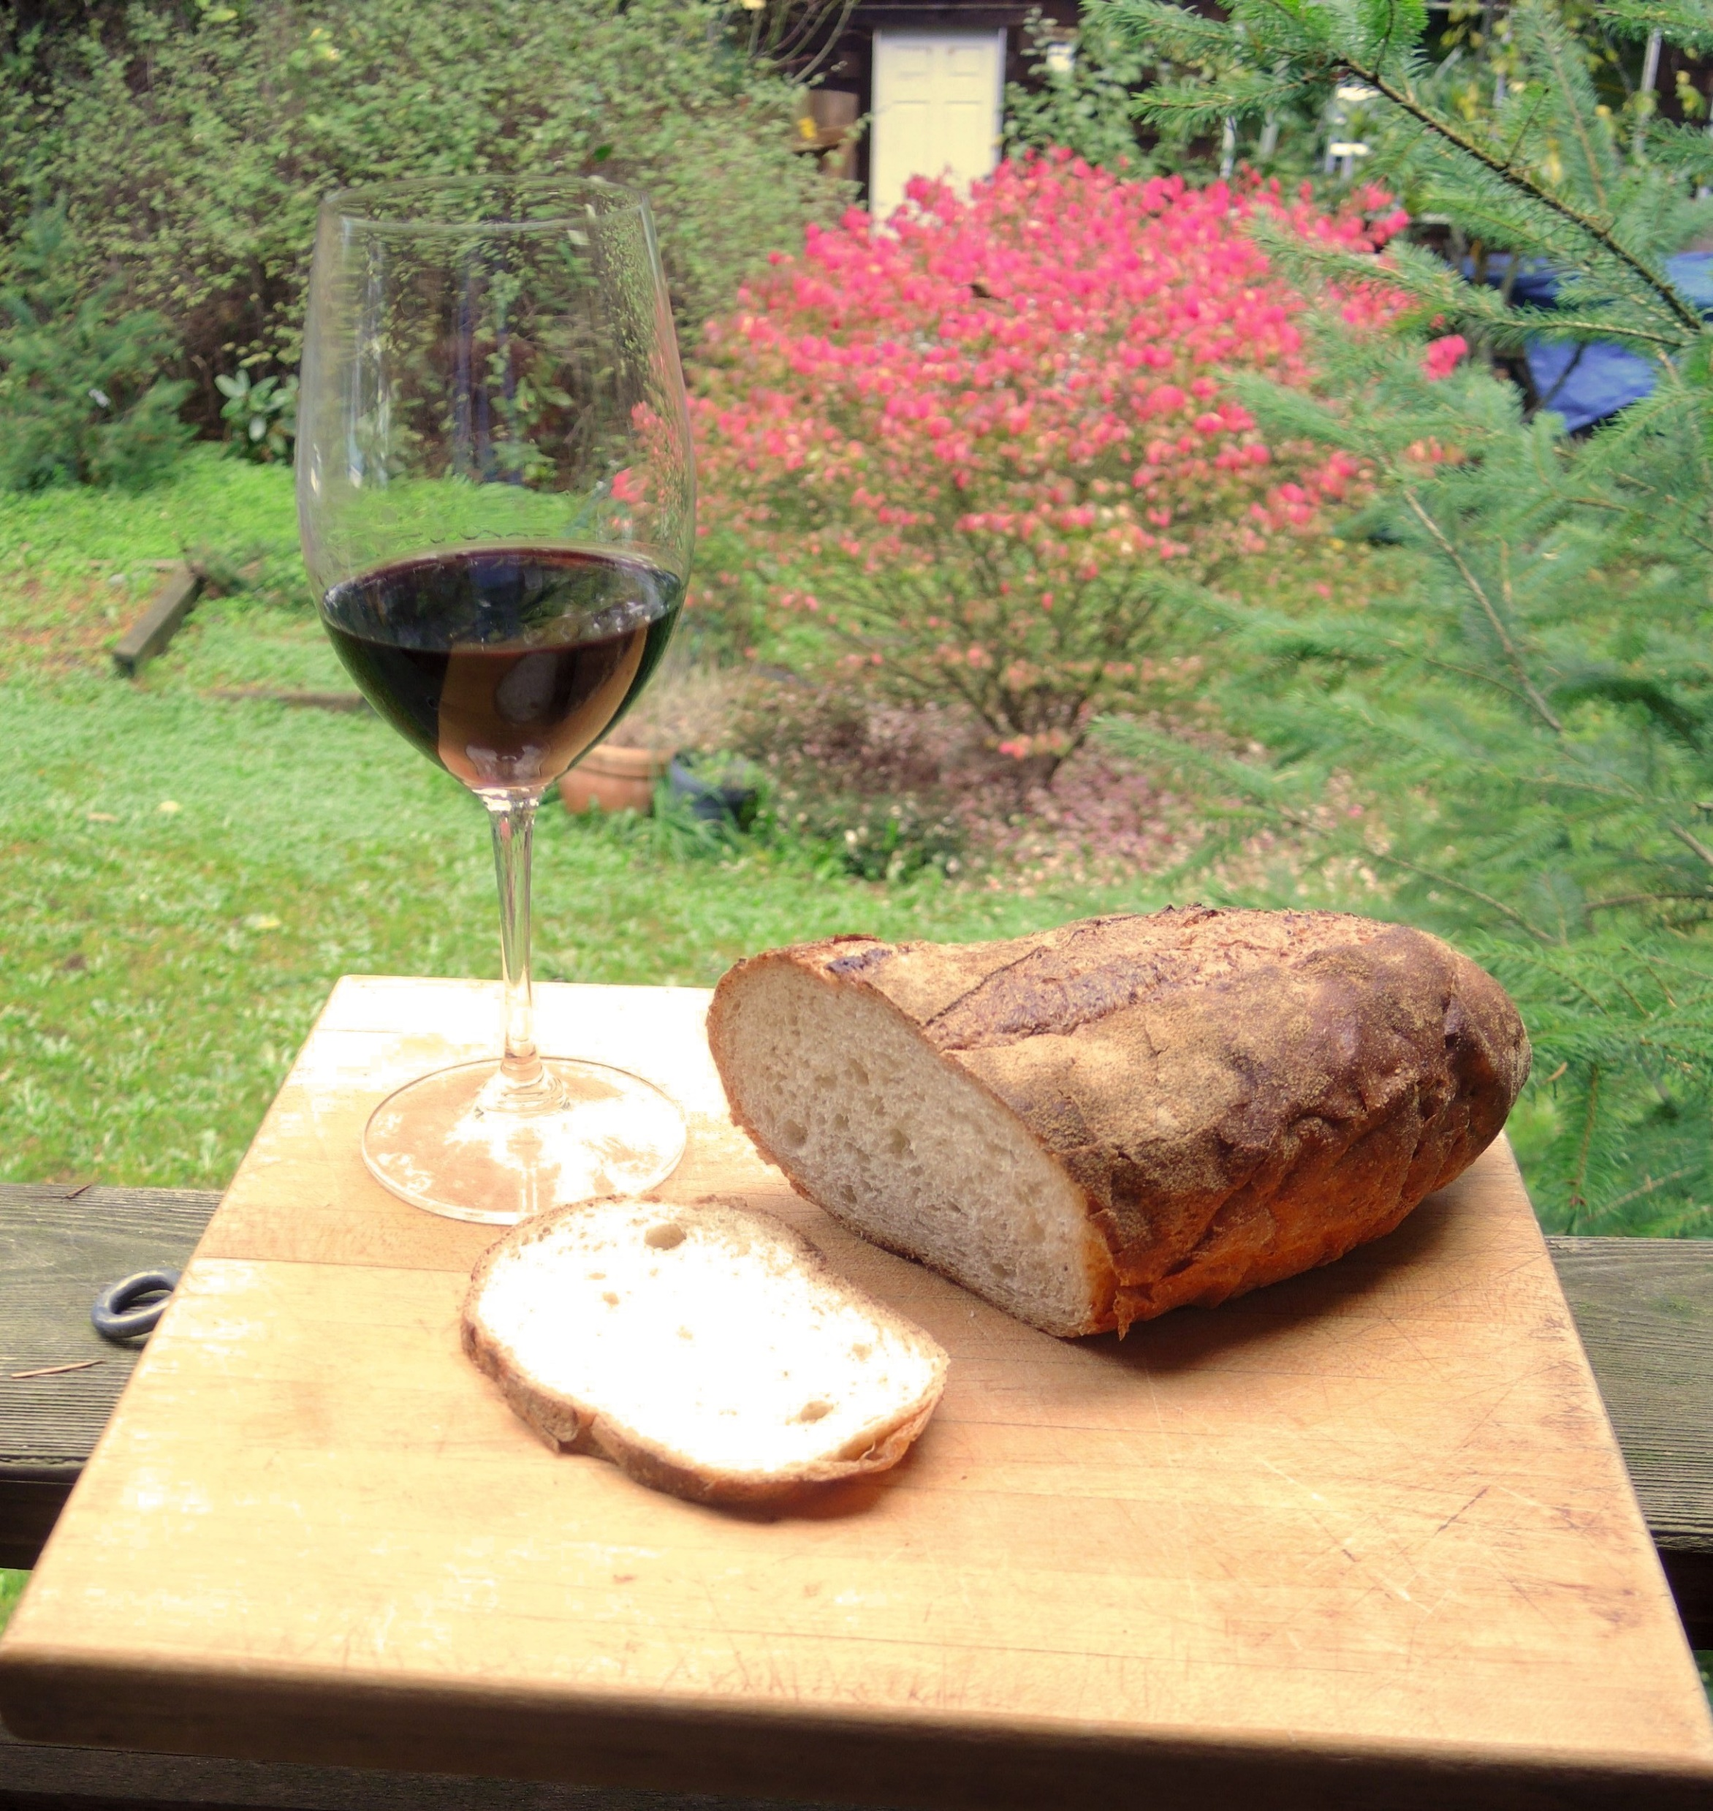
Theology: Creation and incarnation
because of emphases on:
The centrality of Jesus and the Trinity
the goodness of humans and the material world
a sacramental view of the material world as a metaphorical doorway to the divine
So how is all of this expressed?
Notes:
Anglican Spirituality has been described as Incarnational because of its emphasis on:
In Jesus Christ, God became human and shared in our everyday existence. God must value human nature very highly if God is willing, in Jesus Christ, to "take our nature upon him" as ours prayers say, and if God also raises that same human nature to new life after Jesus endured suffering and death. Patricia Bays – Meet the Family
the goodness of material world and sensuality (God’s creation)
a sacramental view of the material world as a doorway to the divine
Sacraments are an essential part of the life of Anglicans.
Sacraments offer a way to contemplate the mystery of God through everyday objects in which God is ‘made flesh’

Slide 9
The Mission of the Church is the Mission of Christ…
To proclaim the Good News of the Kingdom of God
To teach, baptise and nurture new believers
To respond to human need by loving service
To seek to transform unjust structures in society
To strive to safeguard the integrity of creation, and sustain and renew the life of the earth.
www.anglicancommunion.org/mission/marks-of-mission
Notes:
Not every aspect of the Anglican church must do all five of these
Anglican communion Compass rose: words say The Truth Will Set You Free

Slide 10
The Anglican ethos can play out in a myriad of ways in schools
Development of the whole person
How we treat each other as staff
How we teach about faith
How we encourage positive behaviour through restorative justice
How conflict/differences of opinion are managed/resolved
Styles of pedagogy – critical thinking is encouraged
Appreciation of diversity
Encouragement of the Arts
How we are for the school and community environment
And more…

