Slide 1

www.formedfaith.org
The home of

Slide 2
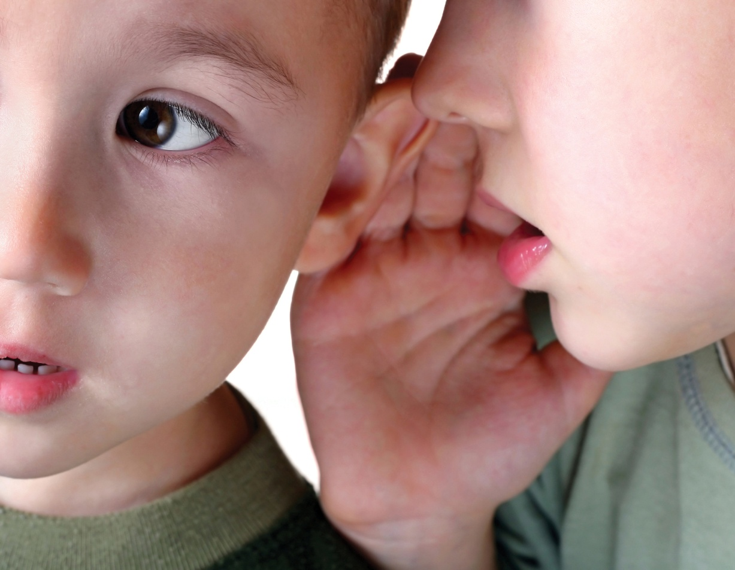
Talking Peacefully about Religious Ideas
Notes:
WELCOME
A. Welcome the group.
B. You may choose to begin with a prayer or reflection. A selection from which to choose can be found in Appendix 3, Introduction to the Program.
NB: This prayer is an optional part of this training module and should be used with sensitivity to those who are part of the group.
C. If you require an ice breaker activity, check Appendix 4, Introduction to the Program, for some ideas, or use one of your own.
NB: It is worth noting that some of the concepts dealt with in this module may touch upon issues that are sensitive for some participants. Because of this, it is suggested that presenters study Handout 2, Using Language Effectively in Religious Education, in preparation. There is also an option to distribute this Handout, if appropriate, with Slide 19.
Resource Box
If you decide to use a prayer, you might…
Invite participants to take part, reading the lines appropriate to them.
Light a candle as a reminder of Christ among you.
Read the prayer together and leave a pause for some silence at the end.

Slide 3
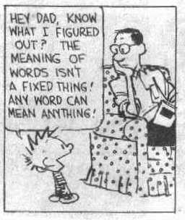
An attention grabbing start!

Slide 4
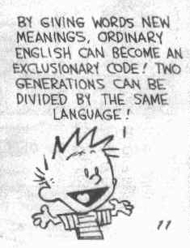

Slide 5
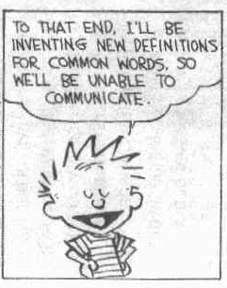

Slide 6
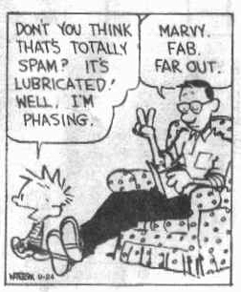

Slide 7
Recognise this?
dad@hvn, urspshl.we want wot u want&urth2b like hvn.giv us food&4giv r sins lyk we 4giv uvaz.don’t test us!save us!bcos we kno ur boss,ur tuf&ur cool 4 eva!ok?
Notes:
Dad@hvn

Slide 8
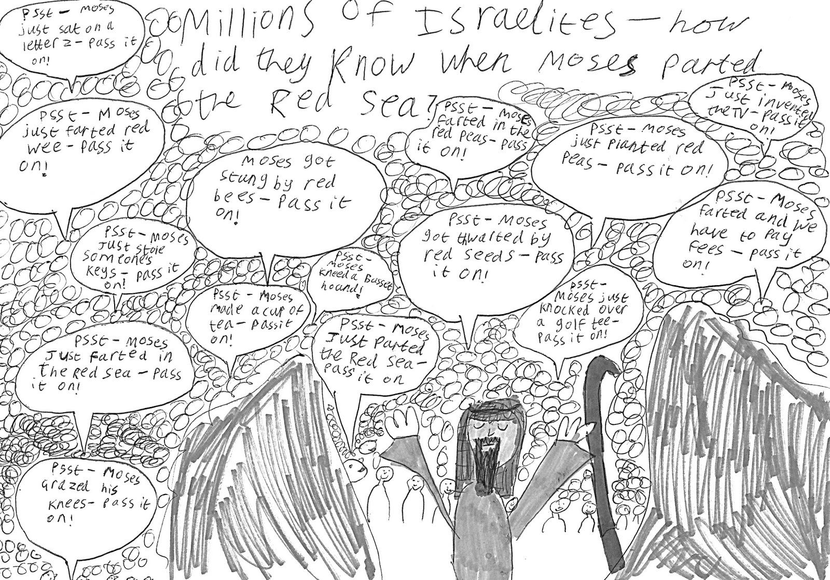
And when it’s a religious idea we’re sharing?
It gets even more complicated

Slide 9
What are some of the difficulties in communicating?
A B
Notes:
2. THE CHALLENGES OF COMMUNICATION
Purpose: to highlight with participants the many challenges of communication, and that these challenges are amplified when religious issues are at hand.
Time:
(A) RAISING THE ISSUES
Introduce the theme of communication skills by displaying the graphic on the slide and outlining a hypothetical situation in which Person A is attempting to communicate some information (M= Message) to Person B. This should be about some mundane topic and not religious at this point.
Pose the question, What are some of the things that might get in the way of Person A communicating this message? Take answers from the group.
Potential responses might be background noise, jargon, lack of interest, listener has other needs which are not met, distracting gestures etc
Make note of the fact that it is easy to find many answers to this question, but when a religious idea is being communicated these difficulties can be further complicated or amplified.
Mention that this half of this module will deal with these difficulties and offer some appropriate strategies for use in the Religious Education classroom.

Slide 10
Do we say what we mean?
Our Father who art in heaven, hallowed be thy name
Still for us He intercedes, His prevailing death He pleads
It is by God’s grace that you have been saved by faith
Gentle Jesus meek and mild ...
Notes:
(B) DO WE SAY WHAT WE MEAN?
Display these statements, which illustrate typical religious sayings, prayers or hymns. Working individually or in pairs, re-write the statements in completely different words, while retaining the original meaning. Pairs may then use individual OHT pens to underline examples on the slide.
After time to complete one translation, talk together in pairs and then discuss the exercise as a total group. Draw attention to the tendency to use religious statements without much thought about the meaning intended, or misunderstandings possible.
You might make mention of the variety of misunderstandings which are possible by using some of these answers supposedly given by students in RE lessons…
Noah's wife was called Joan of Ark.
Moses went to the top of Mt. Cyanide to get the Ten Commandments.
Solomon had 300 wives and 700 porcupines.
Jesus was born because Mary had an immaculate contraption.
The people who followed Jesus were the 12 decibels.
The epistles were the wives of the apostles.
One of the o’possums was St. Matthew.
A Christian man should have only one wife. This is called monotony.
(Source, the Internet.)
If time is shorter, participants can verbally indicate words or phrases on the slide which may be misunderstood.

Slide 11





spirituality matrix?
1. Origins
  - Where does everything come from?
  - Where do I come from?
Purpose
  - Since I’m here, what am I supposed to be doing?
3. How to live
  - While I’m doing it, how should I treat myself, others and the planet?
4. Destiny
  - All that’s fine, but what comes next?
5. Divinity
  - Is there a God? And does that answer make a difference to those above?
Notes:
Concepts then ‘logo’ letters

Slide 12

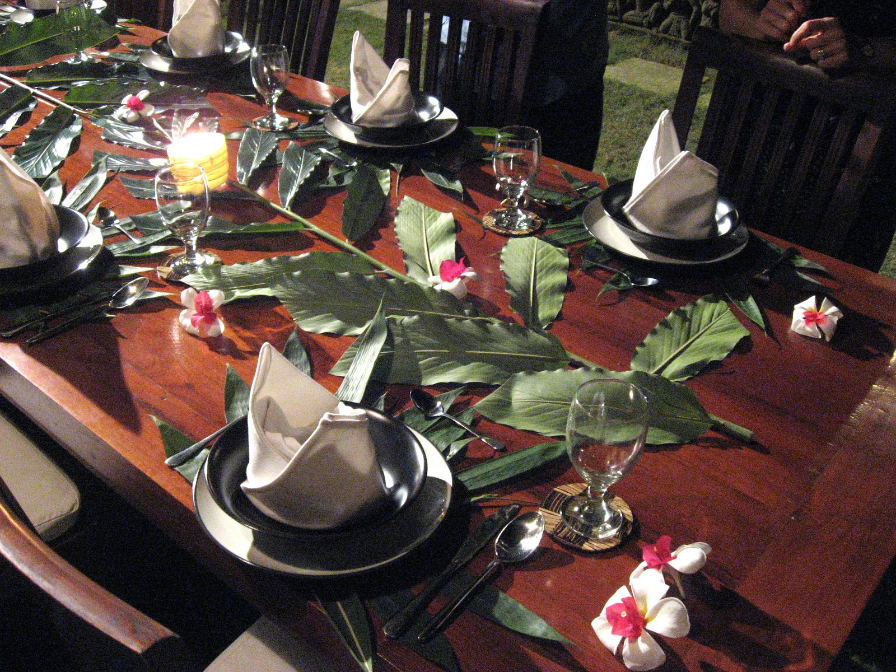

Slide 13

Challenges to religious discussion
Clash of belief systems
Desire to convince others and change their opinions
Feeling of threat
Something else?
Notes:
(C) CHALLENGES TO RELIGIOUS DISCUSSION
Explain that now we will move onto some other language issues in religious education.
Question: “You are at a dinner or a party. What is it not considered polite to talk about?”
Answers: Religion, Politics.
Question: Why is this so?
Elicit responses and list on board or OHT.
Summarise from the collected answers of the group using the OHT.
Clash of belief systems
Desire to convince others and change their opinions
Feelings of threat.
Question: “How would you feel if you were made to listen to someone trying to change your opinion in a current political debate and were powerless to escape?”
(Remember, the point here is not to get into a debate on this subject but to plug into the feelings involved.)
Highlight the point that these considerations have some special messages for us as religious education teachers in terms of the language we use in RE classes.

Slide 14
We need language which
Gives people a way to express their beliefs without threat
Encourages dialogue about beliefs
Avoids unnecessary negative reactions
Leaves people free to consider belief statements and accept them if they wish
Notes:
(D) THE NEED FOR EFFECTIVE LANGUAGE
Emphasise that the challenge we face in doing religious education in our schools is finding and using words and language which achieve the bulletted statements on the slide.
Lead people through the statements, and the conclusion of the list on the next slide.
NB: Dialogue is emphasised here over a monologue style in which --
a. The teacher predominantly talks
b. Only the teacher’s ideas are considered.

Slide 15

Some criticisms of RE teachers
“We had the teacher’s view rammed down our throats”
Fact type statements
and
belief type statements,
Notes:
(E) SOME CRITICISMS OF RE TEACHERS
Highlight the two statements on the slide that students frequently make about RE teachers, which are seemingly contradictory.
Lead the group to consider these 2 issues --
1. Facts and beliefs
2. Presumptive language.
(F) FACTS AND BELIEFS
Elicit definitions for each from participants and write them on the board. Important to note here is that a fact is something which can be empirically proven, e.g. “There are nine people here in the room”. If we then said, “The Holy Spirit is here with us as well,” we have stated a belief, which cannot be empirically proven.
Consider the statements on the Facts or Beliefs? worksheet (Appendix 2) and indicate whether they are fact-type statements or belief-type statements. Participants might do this exercise in small groups.
Statement (c) is an example of Australian Indigenous belief.
Statement (i) is from Hindu teaching.
Statement (j) is from Muslim teaching.
Discuss responses for each statement. Use the Explanation Sheet (Handout 1) to aid your discussion. Point out that participants often find it easier to discern the status of non-christian statements as beliefs and ask why. This sheet can be handed out at the end of the session, if you wish, for participants to take home.
NB: The concepts presented here can be confusing for some participants. It is important to emphasise the perceptions that students may have when we talk about our beliefs as if they were scientifically proven facts, accepted and believed by all without exception, e.g.--
Student: That’s your belief, but it’s not mine.
Or Student: Well, I don’t believe that -- so the teacher obviously is not
talking to me!

Slide 16
So what’s going on?
A fact-type statement...
A belief-type statement...
can be proved or disproved, scientifically, historically or empirically,
or is reporting of personal experience.
requires faith on the part of the believer or believing community.
Notes:
(C) FACTS AND BELIEFS
Explain the definition of a fact-type statement using the slide. Note that a fact-type statement may be proved or disproved; in other words, a fact-type statement may be correct or false but it can be proved as such. A possible example might be to address a class and state, “There are 23 people, in the room at the moment.” This is a fact-type statement because the correct number can be ascertained.
Continue the scenario by stating, “And the Holy Spirit is with us in the room at the moment too.” This is a belief-type statement because it relies on faith. Display the definition on the slide.
Introduce the idea that the problem is that belief-type statements are sometimes expressed as fact-type statements, as if they are true and accepted by all.
Have the participants practise their grasp of this idea using Handout Two, Facts or Beliefs in pairs. If time available is shorter, suggest that not all items need be completed.
Work through the responses on the Handout. Refer to Appendix One, An Explanation of the Facts and Beliefs Worksheet if necessary. This appendix may be distributed to the group at the close of this activity, if appropriate.
Ask the group why it is that most find it easier to identify non-Christian belief-type statements as such. Point out that this may be because we are placed in the shoes of non-Christian students in this position, e.g. “That’s your belief, not mine”, or “This teacher is not talking to me, because I certainly don’t believe that!” Note that the latter is a major problem because these students (potentially, years one through to twelve) may switch off and become alienated from the subject matter.

Slide 17
Implications of language issues
Rarely, if ever, are the pronouns
WE, (e.g. We know God
made the world)
OUR, (e.g. Our church is
St Peter’s)
or
US, (e.g. Jesus died for us)
appropriate.
Notes:
(B) IMPLICATIONS OF LANGUAGE ISSUES
Highlight the point that, having looked at these language issues, there are certain implications for us if we want to do the job as well as we can. Lead the participants through the implications on this and the next slide.

Slide 18

The Solution to these dilemmas?
Well?
Notes:
5. OWNING AND GROUNDING
Purpose: To introduce participants to the concepts of owning and
grounding and facilitate some practice in using them.
Time: 30 minutes
(A) THE SOLUTION TO THESE DILEMMAS?
Display the slide and read through with suitable fanfare.
Explain that the solutions to these dilemmas lie in the answers to two questions --
Who says it? and
Who believes it?
And in the concepts of owning and grounding.
Explain that we will now look at these issues in detail.

Slide 19
What is Owning?
Owning is when I claim a belief as mine and present it to the students for consideration.
Owned statements begin with phrases like
I believe... I think...
I feel... In my experience...
It seems to me...
Notes:
(B) WHAT IS OWNING?
Lead participants through this material.
Resource Box
You could…
(1) Have participants use the Language worksheet (Appendix 3).
Note that some of the statements require use of the grounding technique. Participants, in effect, discover this as they proceed and it becomes a good way to introduce the next slide.
OR
(2) In pairs --
Make 3 statements.
Change them to an “owning” statement together.
OR
(3) Quiz your partner by sharing statements and asking if they indicate use of the “Owning” strategy.

Slide 20
What is Grounding?
Grounding is when I “Ground” the belief statement by attaching it to the group who holds it, or to its source.
Grounded statements begin with phrases like
Many Christians believe ...
In the Bible, Paul says in Romans 8 …
The Uniting Church teaches ... or
For Anglicans ...
Notes:
(C) WHAT IS GROUNDING?
Lead participants through this material. You might use a similar strategy to that suggested on the previous slide, or ask participants to identify the statements which require grounding on the Language worksheet (Appendix 3).

Slide 21
Owning Grounding
Claiming a belief as one’s own by using phrases such as
  “I believe…”
  “I think…”
  “In my experience…”
Attaching a belief to a group of people or a source from which it comes.
  “Christians believe…”
  “The Anglican church teaches…”
  “Micah 6:8 says…”
Notes:
(C) SOME PRACTICE
Have participants practise the use of these strategies by distributing O&G Cards (made up from masters in Appendix Three) to groups of three.
Statements on the cards must be converted into either Owned or Grounded statements using the sentence starters on the slide or others.
If time allows, cards may be passed on from group to group.
An option is to use competition as a motivator for this activity by having groups score against each other.
Work through statements, taking responses from the group and affirming appropriate use of the owning and/or grounding strategies.

Slide 22
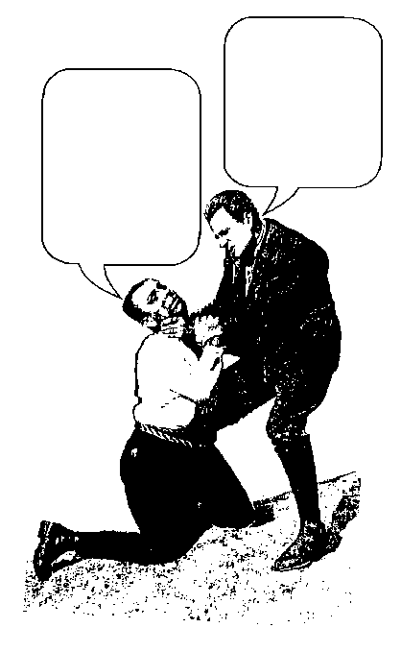
Some points about Owning and Grounding
1. They do not prove a belief or claim
it as authoritative for all
BUT
they free people to hear the belief,
and consider and discuss it.
2. They make beliefs sound
less dogmatic
BUT
they make the source of authority
for the belief, whether in personal
experience or tradition, clear.
Sure is!
That’s great!
Notes:
(D) SOME POINTS ABOUT OWNING AND GROUNDING
Group participants in threes to list the positives and negatives of Owning and Grounding. Give them time to do so.
Take the responses from the group.
Lead participants through this OHT, highlighting links between the positives that groups produced, and the text.

Slide 23
Language and our aims as Religious Educators
If I seek to do things with people such as
  walk with
  educate
  inform
  allow to develop
  lead to make their own decisions
  develop mutual respect
then owning and grounding techniques become crucial, respectful tools.
Notes:
(E) LANGUAGE AND OUR AIMS AS RELIGIOUS EDUCATORS
Highlight the point that the issue of language in religious education raises another issue: “What are our aims as religious educators?” Display the OHT and go through it.
Referring back to the slides entitled “Challenges to Religious Discussion” and “We Need Language Which…”, focus on the fact that Owning and Grounding are very useful ways to get around the possible problems, and to address RE issues in ways that create an atmosphere of receptivity and rapport.
Distribute Handout 2 (Using Language Effectively in RE) now, as further reading, if appropriate.
NB: An occasional criticism by those new to these concepts is that using owning and grounding may take away the power of Christian statements. Those more familiar with their usage would say that statements derive more power, in that they are rooted in the positive relationship that the teacher has with students.
Resource Box
Some Other Ways of Doing This Slide
An overlay OHT showing each ticked point as an upward step on a flight of stairs.
Each ticked point as a jigsaw piece which fits together to complete a jigsaw puzzle.
Each ticked point as a brick which makes a sturdy wall of religious education.

