Slide 1
Engaging Adults in Tertiary Education

Slide 2
Knowledge
Learning

Slide 3
Traditional Classroom?
Begins with parts of the whole–Emphasizes basic skills
Strict adherence to fixed curriculum
Textbooks and workbooks
Instructor gives/students receive
Instructor assumes directive, authoritative role
Assessment via testing / correct answers
Knowledge is inert
Students work individually
Notes:
The Traditional Classroom
Begins with parts of the whole–Emphasizes basic skills
Strict adherence to fixed curriculum
Textbooks and workbooks
Instructor gives/students receive
Instructor assumes directive, authoritative role
Assessment via testing / correct answers
Knowledge is inert
Students work individually
The constructivist Classroom
Begin with the whole – expanding to parts
Pursuit of student questions / interests
Primary Sources / manipulative materials
Learning is interaction – building on what students already know
Instructor interacts / negotiates with students
Assessment via student works, observations, points of view, tests. Process is as important as product
Knowledge is dynamic / change with experiences
Students work in groups

Slide 4
Constructivist
Notes:
Piaget!!

Slide 5
Constructivist
A more modern classroom?
Begin with the whole – expanding to parts
Pursuit of student questions / interests
Primary Sources / manipulative materials
Learning is interaction – building on what students already know
Instructor interacts / negotiates with students
Assessment via student works, observations, points of view, tests. Process is as important as product
Knowledge is dynamic / change with experiences
Students work in groups
Notes:
A more modern classroom, especially for younger children?
The constructivist Classroom
Begin with the whole – expanding to parts
Pursuit of student questions / interests
Primary Sources / manipulative materials
Learning is interaction – building on what students already know
Instructor interacts / negotiates with students
Assessment via student works, observations, points of view, tests. Process is as important as product
Knowledge is dynamic / change with experiences
Students work in groups

Slide 9
Introducing the Learning Focus
Skill 1: Identifying what the learner already knows
Notes:
Its an obvious place to start, but starting by asking students to REMEMBER what they already know does a couple of things for you and for the student
For you
Gives you some clues about the lay of the land, who knows what,
It allows you to pitch your lectures appropriately
It allows you to build in some meta cognition exercises in the coming weeks.
These are times when you rise above your own thinking to view it as if from above, to examine, critique and even adapt your own thinking
For the student
Gives people a chance to collect their ideas and seem competent (always a comfortable position in a classroom)
Is an invitation to express themselves in a non-threatening way – no one gets put on the spot
Allows students to get to know one another
In a classroom relationships are v important
LOTS OF DIFFERENT WAYS TO DO THIS
BUT ONE REALLY GREAT ONE IS TO GET EVERYONE TO DRAW A MIND MAP

Slide 10
The Mind Map Book – Tony Buzan 1996
Notes:
This elegant and simple technique (developed by Tony Buzan) provides a structure for organising thoughts on a topic.
See this example
Basic process
Image in the centre – allows creative response
Organic lines emanating from that main topic to “chapter headings”
And so on with 3rd order ideas and so on.
Creating a mind map is a good one for a “home” task, or an initial in class task for use in introductory session..SAVES GOING AROUND THE ROOM

Slide 11
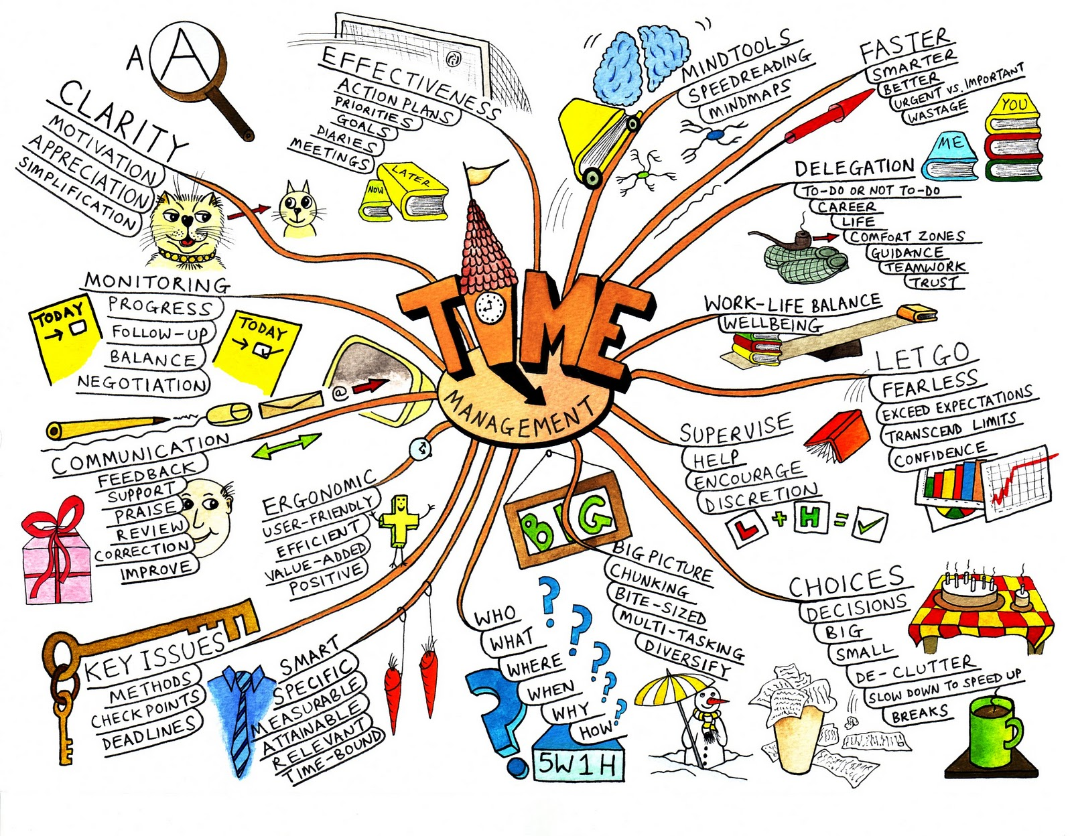
Mind Map Laws
Techniques
Use emphasis
Use association
Be clear
Develop a personal style
Layout
Use hierarchy
Use numerical order
The Mind Map Book – Tony Buzan 1996

Slide 12
The Mind Map Book – Tony Buzan 1996
Notes:
PLENTY OF STYLES TO CHOOSE FROM
EVERYONE COULD DEVELOP THEIR OWN.
ALSO GREAT FOR MAKING CONNECTIONS AS YOU GO THROUGH THE COURSE.
ADD/ADAPT/CRITIQUE AND “CORRECT”//

Slide 13
The Mind Map Book – Tony Buzan 1996

Slide 14
The Mind Map Book – Tony Buzan 1996
Notes:
If you have a hint that some know more than others, you could always buddy up to produce a mind map…then it becomes a collaborative effort and no one is left obviously out of it!
So let’s create one, in groups of ____ with this topic –What do people already know About the Bible?
What are big areas to know? OT, NT, GENRE, HOW TO READ IT, CANON DEVELOPMENT
Then brainstorm under each big area…

Slide 15
K.W.H.L
What do I KNOW | What do I WANT to know
HOW will I find out | What have I LEARNT
Notes:
This can be used to establish expectations for the course!
Encourage people to explore the “what do I want to know” and “how will I find out” sections.
At the end of the course you could revisit these and see if people can fill in the “what have I learnt?” section!

Slide 16
looks like
sounds like
feels like
Notes:
Explain Y Chart
Imagine the world of First Century Jerusalem

Slide 17
The World of Paul
looks like
sounds like
feels like
Notes:
Now have a go at this in groups of ____.
The world of Paul
What we know about 1st Century world inhabited by Paul.
Let's collect some ideas.
A value-add exercise is to then
Pair up and compare.
Ask each other how you know what you know.
Identify similarities and differences.
Can be used as an introductory exercise...to the topic, but also in the first lecture, to introduce the students to each other and to you.

Slide 18
Introducing the Learning Focus
Skill 2: Stimulate interest when introducing a topic

Slide 19
https://www.youtube.com/watch?v=42nMkSNmCzM&ytbChannel=null
Example of a clip to use to create interest in a subject area – This clip from On The Waterfront (1954) might be used in week one of Homiletics? Being the Church? Jesus the Christ?

Slide 20
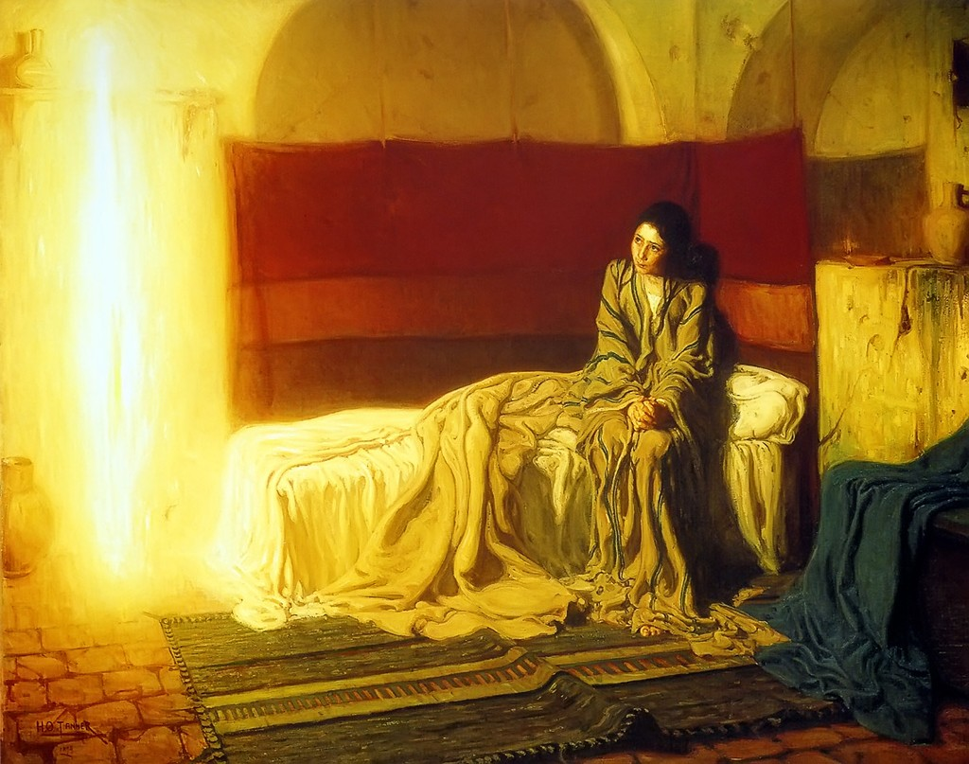
Notes:
The Annunciation by African-American artist Henry Ossawa Tanner (1857-1939), painted in1898.
http://studiomatters.com/a-domestic-annunciation

Slide 21
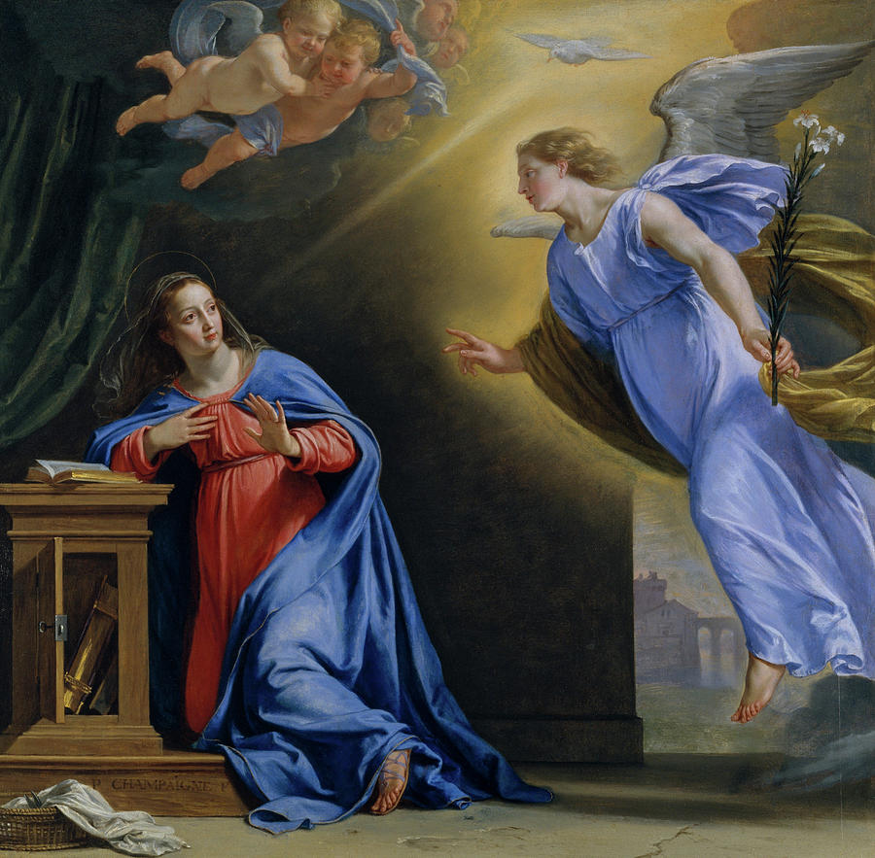
Notes:
Artist: Philippe de Champaigne (French, Brussels 1602–1674 Paris) Date: ca. 1644
Medium: Oil on oak

Slide 22
Picture Stimulus

Slide 23
Methods for Collaborative Learning
Skill 3: Helping learners share their thoughts

Slide 24
Think Pair Share
Notes:
The problem? – groups that need to warm up a little
The answer Think Pair Share
What are your three favourite movies?

Slide 25
Use silence with purpose
Notes:
Use silence with purpose - In order to share thoughts, you need to have thoughts
In a section that is about sharing thoughts, it seems weird to talk about creating silence…but…
Everyone processes ideas/instructions differently
Does your group have people who…
Process information quickly?
Take time to make connections?
Prefer to rehearse their thoughts?
Take any opportunity to talk?
Announcing that an activity comes with silent thinking time is a total gift to many.
The trick is to actually GIVE the 30 seconds and allow people to make notes
Follow this up with the think/pair/share to let people test out their ideas on one person before adding to the group discussion

Slide 26
Methods for Collaborative Learning
Skill 4:
Creating the environment
and
providing activities
that stimulate learning
Notes:
This is a whole workshop in itself,
Let’s take a look at some ideas to stimulate learning.
Activities
Be clear about the aims
Make them retrievable
Return to them, check in and ensure the group is on track
Every activity needs to be
Clearly stated and retrievable
Have an advertised time limit
Have all the required material ready/accessible
Ideally in one session/lecture, there should be activities that cater to the range of different learning styles.

Slide 27
Stimulating environments
Notes:
Environment
Accessible
Open
Comfortable
Allows easy movement for breaking into discussion groups
Safe
Physically
Emotionally
Mentally
Spiritually
Respectful
Positive
Allows for relationships to flourish
Establish boundaries.
Remember: toddlers push the boundaries with great energy – they will keep pushing until the boundaries stop moving. Then they relax in the knowledge that they are safe and secure.
Adult learners can be like that too.
Eg: if you expect readings to be done at home during the week, then look carefully at the expectations.
Are they achievable?
Interesting?
Is there clear reason for a time poor person to dedicate time to the activity?
Is there something to produce/bring to the next lesson that allows you to quickly ascertain that the work has been done?
One history lecturer said that every day he brought one item from the outside world into the classroom. Each lecture started with the new item. He would explain how the topic for the day related to the item.
Umbrella…grabbed at the last minute – spent the trip to work linking umbrellas and trench warfare.
The point is…it creates an environment of enquiry, curiosity, engagement, anticipation.
Every student came in anticipating an interesting start to their time together. I can only guess what they thought when they saw him sitting on the desk with an umbrella over their heads.
What happens when you suspect that some have not done the work at home?
Think pair share
What are some ideas for setting boundaries with this?

Slide 28
Stimulating activities
Notes:
Activities
So you have 100 units of information to download into each brain by the end of semester.
You could read and talk your way through the term, certainly that’s been a standard mode of tertiary education delivery in the past…
What you can do is to ensure that those units of information are consumed and digested in ways that allow students to engage and interact with the content, to own it and work with it.
Not all day every day, but here’s a chance to do one part of each lecture specifically targeted at engagement.
Simply
Text or stimulus
+
Aim
=
Opportunity for engagement
So, you have an alphabet to remember, I know Marie-Louise has songs to encourage people to remember the basics.
Peter used film clips last year, a great way to make connections between the known world and the world of ideas.
Generally
Anything that connects different brain activities will ensure deeper engagement, more efficient learning.
On that note, research shows that learning is more effective when the whole body is engaged. I’m not suggesting line dancing, but little things like adding a group activity that takes place in the back of the room rather than at the ordinary desks.
If the activity is only 5 minutes, gather in groups standing up!
Do a short brain gym activity at the 1 ½ hour mark after a break

Slide 29
Text
+
Aim
=
Opportunity
Notes:
Simply
Text or stimulus
+
Aim
=
Opportunity for engagement
Choose one thing in each session that you can say:
I really want them to get (point) from this stimulus (passage/text/evidence/poem/video…)
A very simple activity takes advantage of a particular type of brain function.

Slide 30
RETICULAR ACTIVATION SYSTEM
This Photo by Unknown Author is licensed under CC BY-SA
Notes:
We so often read a passage, show a video with the hope they will find it totally engaging and bubble with discussion about the content afterwards.
Such a bummer when people seem incapable of remembering anything at all!
We can take advantage of a particular brain function – the RETICULAR ACTIVATION SYSTEM – part of the flight or fight mechanism.
It’s a primitive function to do with awareness – it’s purpose is to keep us safe.
Eg: it’s active when a kid enters a playground, and is able to pick their bully out of a crowd of hundreds.
Its active when an experienced driver is admiring the scenery and then abruptly focusses on a white vehicle parked on the side of the road…and touches the brake
As educators, we can use the RETICULAR ACTIVATION SYSTEM or RAS to make learning successful.
Next time you have a reading or lecture for your group…spend 5 minutes thinking
“what do I want the group to get out of this?”
Before you launch into the reading/lecture/video, write up/present/make retrievable, what you hope people will gain.

Slide 32
Methods for Collaborative Learning
Skill 5: Helping learners identify their values

Slide 33
Methods for Collaborative Learning
Skill 6: Providing activities for collaborative learning

Slide 34
Communicating
Skill 7: Communicating ideas and information clearly

Slide 35
Reflection of Learning
Skill 8: Helping learners reflect on what they have learnt

