Slide 1
Enabling Lay Ministry
Working where you are
with those who show up
Notes:
Jonathan

Slide 2
Think about your place
What are the top 3 things
you notice about the lay people in your place?
Enabling Lay Ministry
Notes:
Fiona

Slide 3
What increases the chance of volunteering for ministry?
“It is the laying on of hands in baptism, not ordination, that initiates a life of Christian service modelled after Jesus”
Enabling Lay Ministry
Notes:
Fiona

Slide 4
Lay ministry – more than parish council…
Enabling Lay Ministry
Notes:
More than just parish ministry – Schools too etc

Slide 5
Effective lay ministries -
Common principles?
Examples of specific ministries will come to mind – let’s go deeper!
What is it about those specific examples that make them work
Enabling Lay Ministry
Notes:
Eg: Community meals at Chermside parish
needed and appreciated
Volunteers get to live the gospel: feed the hungry
Simple formula, easily repeatable
Makes connections with rough sleepers and lonely
Church into community, community into church
Volunteers get a sense of satisfaction
They can invite others to join
Encourages sense of ownership
Makes use of the gifts of the parish: space, cooking skills, hospitality skills, organisation skills

Slide 6
Activity: Hot Potato
Common principles for effective lay ministry…
Your group thinks about one question
Stay put and make notes
Send the paper to the next group
Read what they wrote
Add bits
Move paper again
Enabling Lay Ministry

Slide 7
What principles help make lay ministry successful under each heading?
LEADERSHIP STYLE
STRUCTURES
PROJECTS
RESOURCES
Enabling Lay Ministry

Slide 8
Leaders who enable lay ministry are…
Aware of their blind spots
Happy to share
the spotlight, the glory, the hard work, the blame
Encouraging
Empowering
Willing to manage people when needed
Consider the ‘barnacles’
Welcoming of new ideas
Humble
Risk takers
prepared to back an idea or person, or to let go when needed
Enabling Lay Ministry
Notes:
Jonathan

Slide 9
Structures that enable lay ministry have…
Clearly expressed role descriptions
Allow for personal expression
Clear time limits: an escape clause
Routine mentoring/training
Routine oversight
Celebrate beginnings and ends
Allow for redundancy
Pathways in, pathways out and pathways for progressing through
Time for creative thinking and questioning
Enabling Lay Ministry

Slide 10
Projects that enable lay ministry…
Are useful, make a meaningful difference
Are challenging enough… but don’t ‘deep-end’ people
Allow ownership
Encourage growth in faith and understanding
Give volunteers social and personal satisfaction
Allow the outside community to engage
Have a time limit
Have a measure of success
Allow the faith community into the world and invite the world into the faith community
Enabling Lay Ministry
Notes:
JOnathan

Slide 11
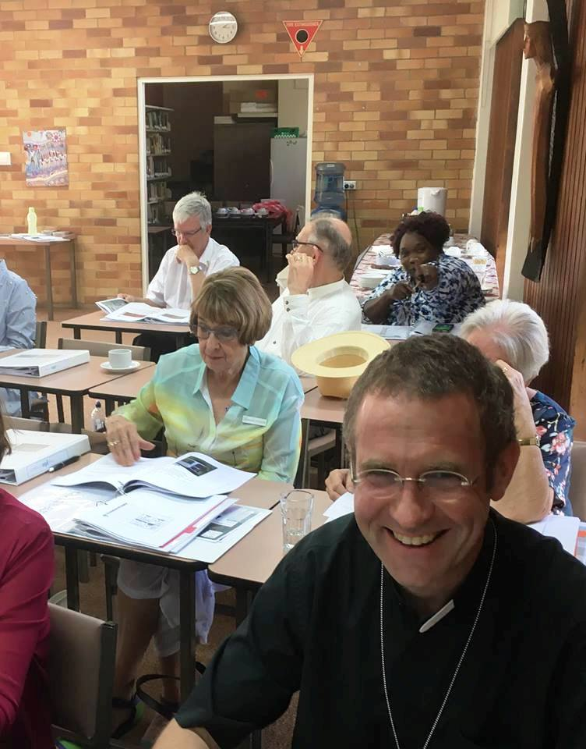
Resources that enable lay ministry…
Are tested
And trusted
Are age appropriate but challenging enough
Are relevant to the community
Allow for group dynamics
Provide support for leaders and participants
Acknowledges different emphases or points of view, values creative tension
Are sensitive to jargon
Leaves it out or explains
Enabling Lay Ministry
Notes:
Fiona

Slide 12
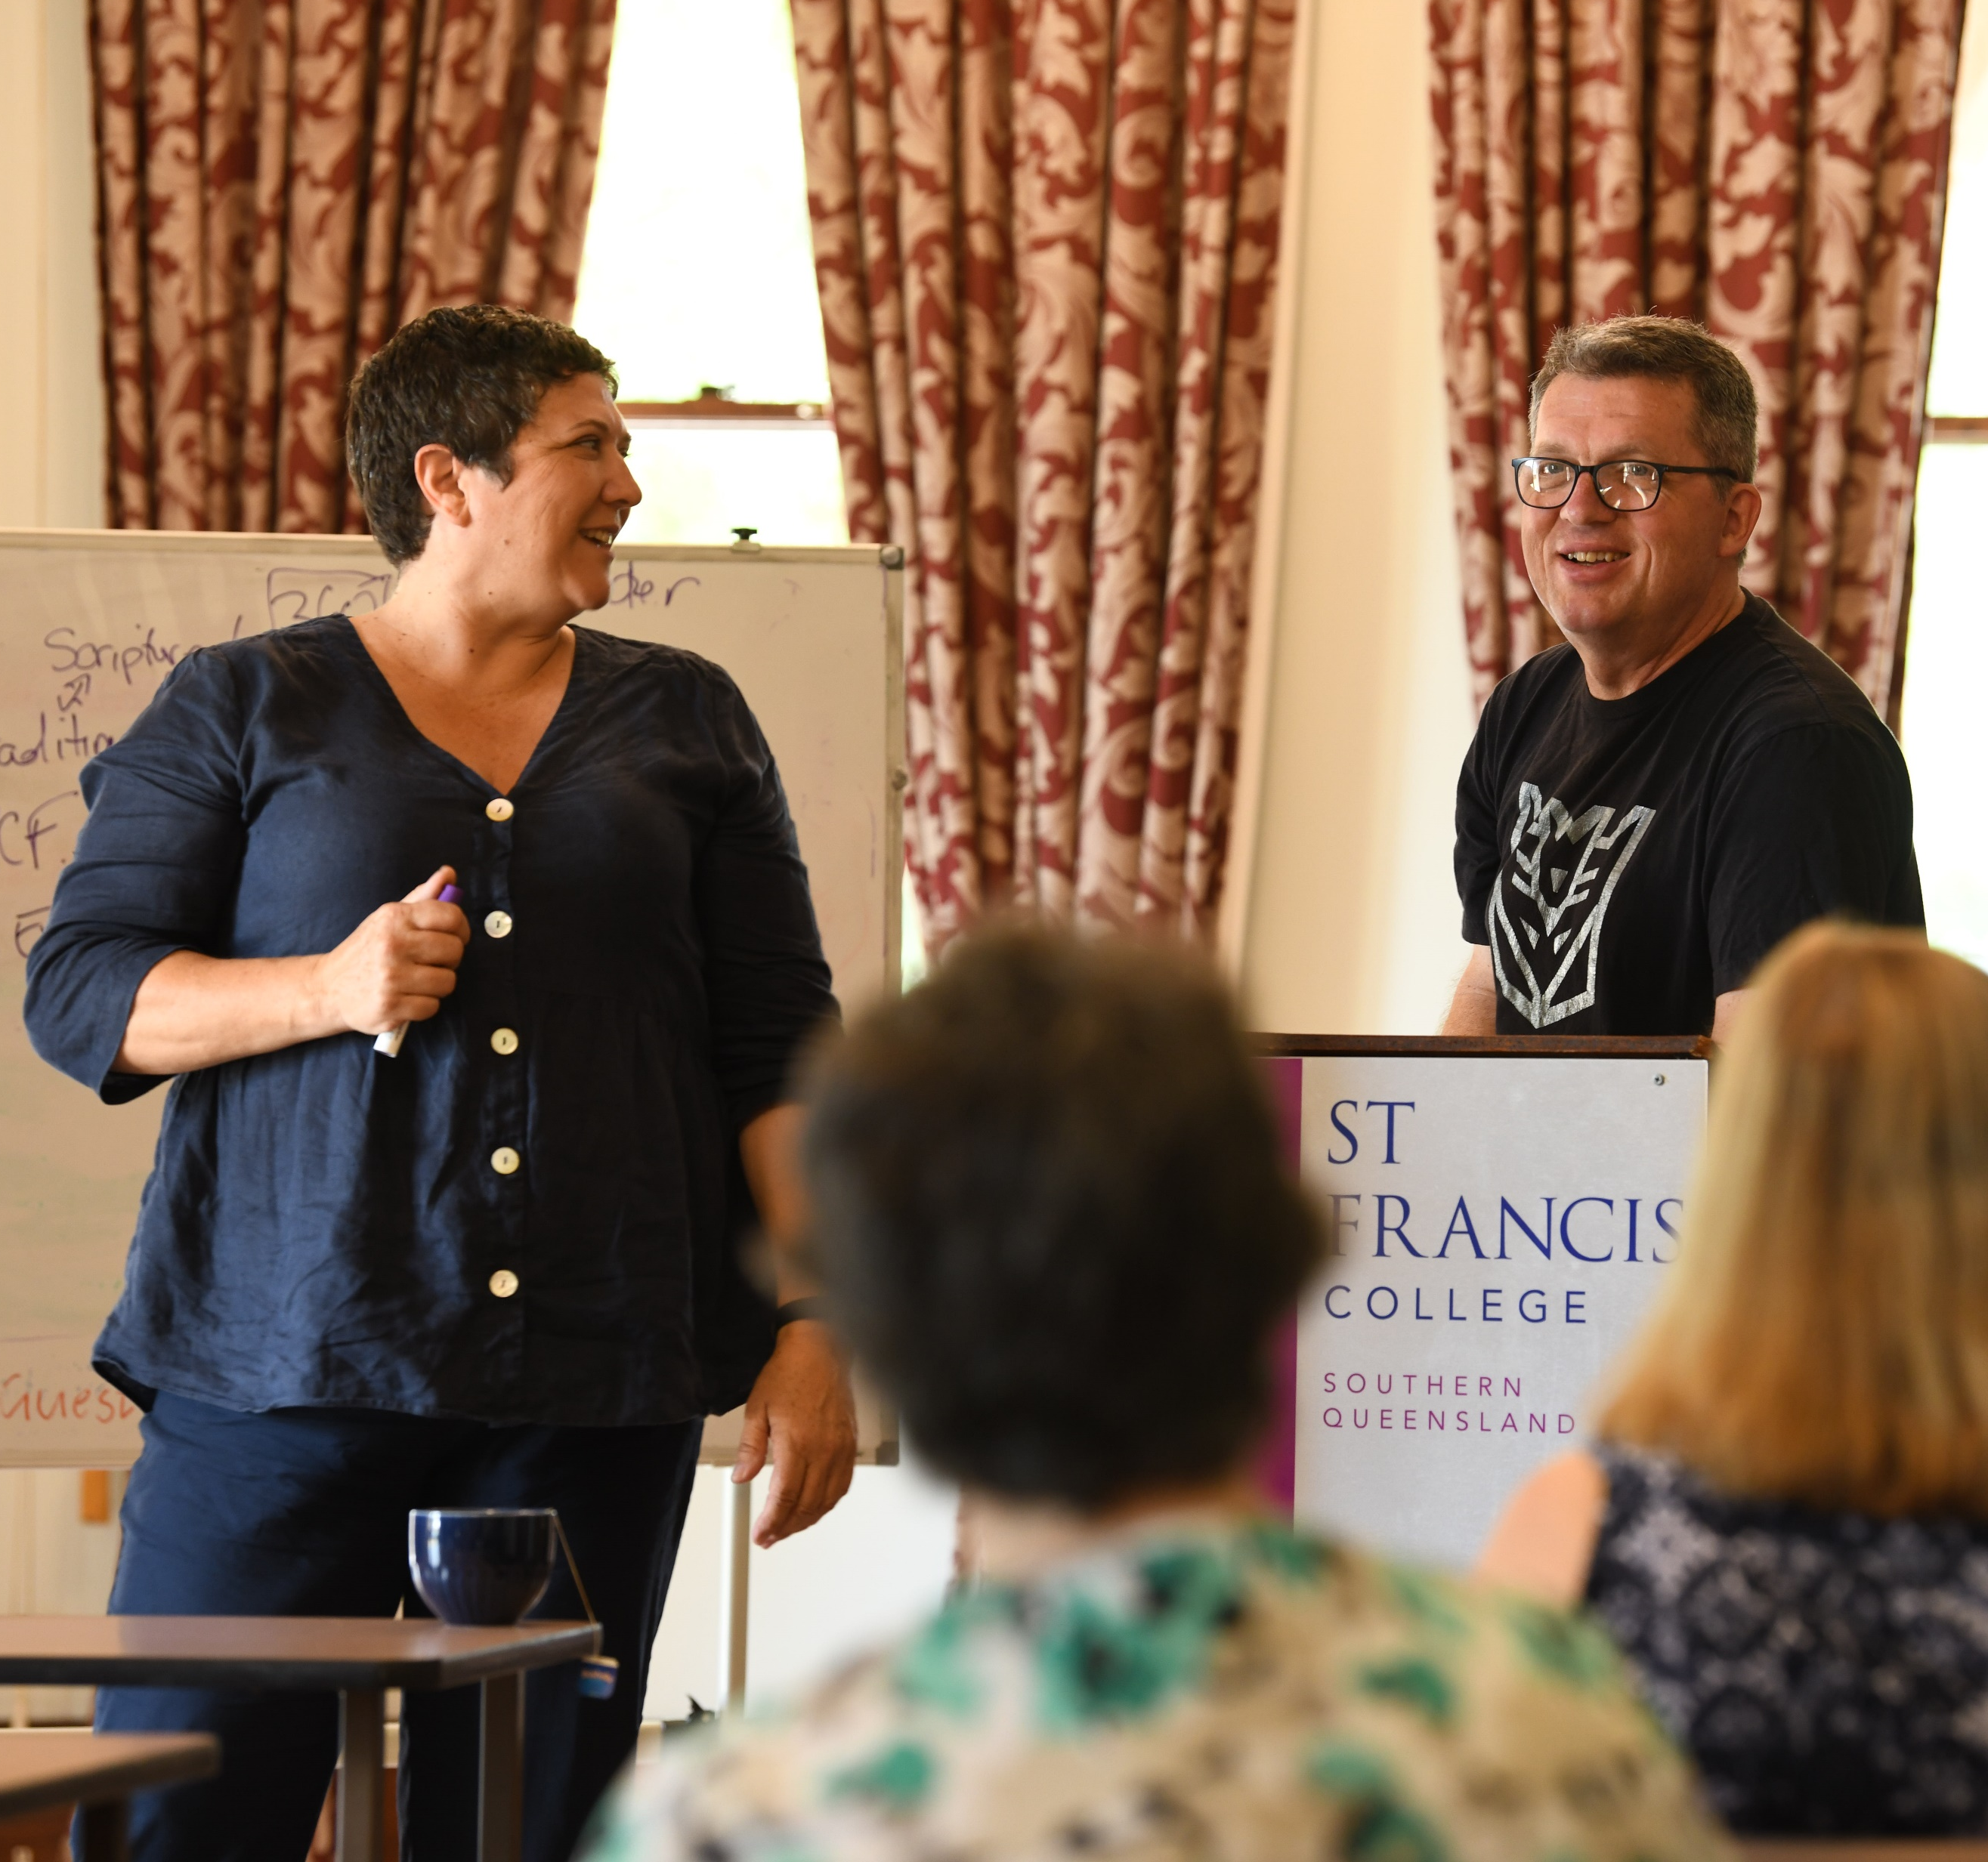
formedfaith.org
360 Project
SFC Short Courses
Anglican Identity
Enabling Lay Ministry
Notes:
JOnathan

Slide 13
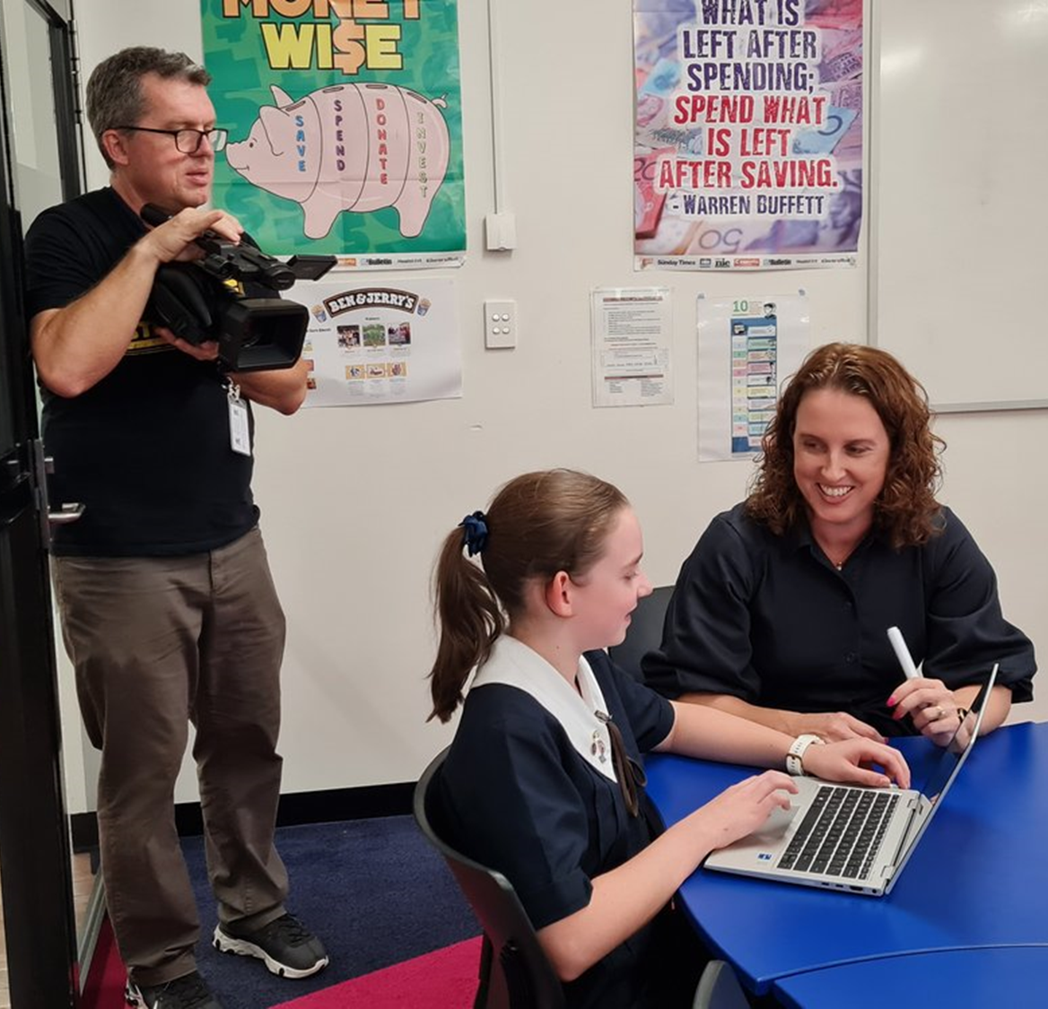
formedfaith.org
Enabling Lay Ministry
Notes:
JOnathan
Home of the John Roberto Intergenerational faith formation material
Home of Pilgrim: small group faith formation study groups written by acclaimed Biblical scholar Paula Gooder and others
Home of very useful resources on small groups, training
Resources for growing faith and training lay people for ministry
Features latest ventures in lay ministry education

Slide 14
360 Project
Enabling Lay Ministry
Notes:
Fiona
Bible 360: Intro to the Bible
Bible 360: Intro to the Prophets
Bible 360: Exploring the Gospels
Faith 360: Puzzle of Paul
Faith 360: Faith Seeks Understanding
Faith 360: Praying in Anglican Ways
Mission 360: Opening the Circle
Mission 360: Small groups ministry

Slide 15
SFC Short Courses
Enabling Lay Ministry
Notes:
Jonathan
What matters about Jesus?
Being Anglican
Faith Asking Questions
Exploring the Bible
Understanding Worship

Slide 16
Anglican Identity
More info at formedfaith.org
Enabling Lay Ministry
Notes:
Trailer next?

